Slide 1


Visualization Methods for Deep Learning Interpretability
-
Final presentation (P4)
Sébastien David, Matthieu Desse, Antoine Hue, Romain Legrand
June 25th 2020
Notes:
· Rappeler très brièvement le contexte et les enjeux du projet
· Décrire les moyens (humains, techniques, méthodologiques) mis en oeuvre pour atteindre les objectifs ainsi que les difficultés rencontrées
· Présenter la solution proposée, ses avantages/limites et esquisser des perspectives de développement futur.

Slide 2
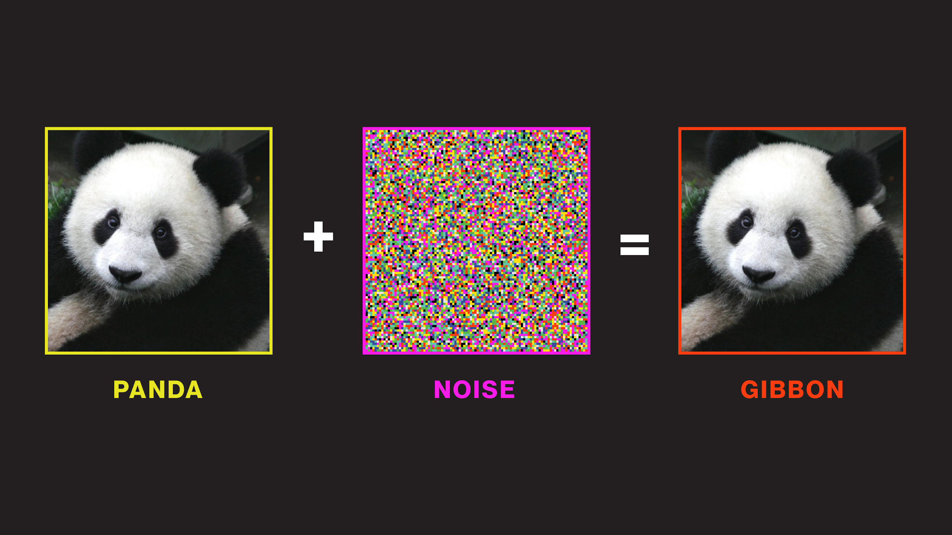
Context, organisation and challenges
Notes:
Durée : 4 minutes

Slide 3
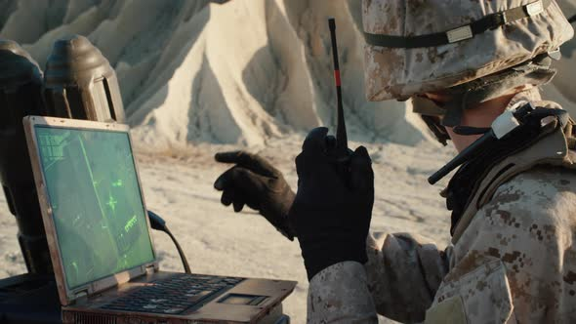
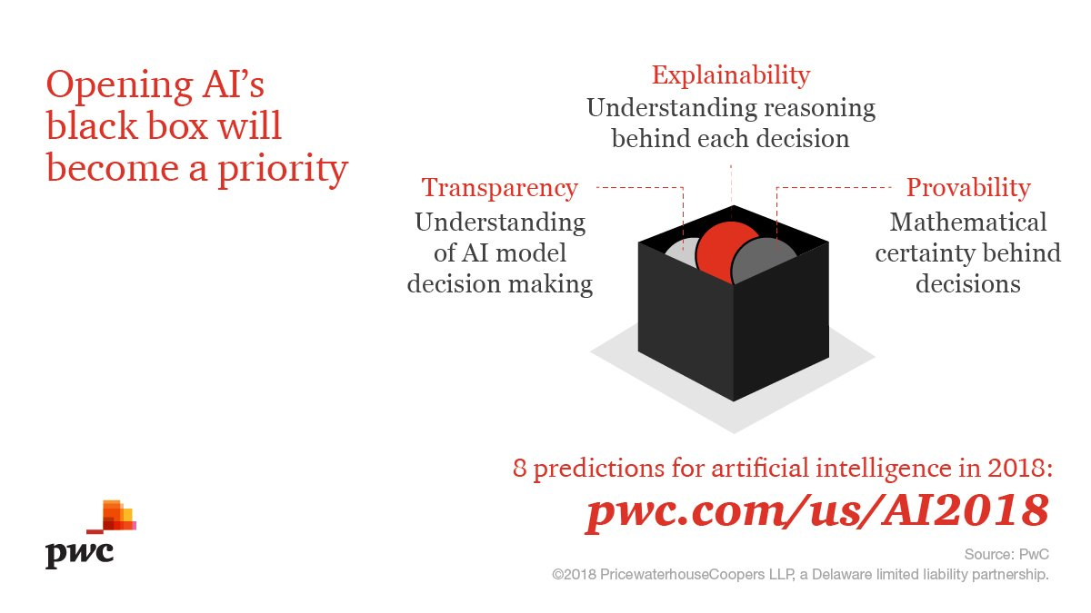
Context
Ministère des Armées’ interest for Deep Learning applications
Applications : assisting soldiers on the battlefield, geo-spatial localization, telecommunications, etc.
AAA
Project goals
Deep Learning = black-boxes
Answer interpretability deficiencies during model training …
… or at prediction time
spécifique
Notes:
The Ministry uses some DNN to response to this need.
Indeed, training phase has high cost (time and hardware)
The Ministry need to observe the good or not training of a DNN through 2 main axis :
Understanding training phase and the invariant of a DNN on a specific task
And define metrics to monitor this train.

Slide 4
Roadmap
08/01/2020
1st Phone Call with Ministère
28/04/2020
P3 Presentation (distanced learning)
11/2019
Project launch
04/02/2020
P2 Presentation + 1er Meeting with representatives from Ministère
25/06/2020
Final presentation +
Documentation
Research literature review
State-of-the-art
Technology review
Initial POC
Prototyping different interpretability methods
Conclusion of our POC
Improvements
Documentation

Slide 5
Setbacks and challenges
Ajouter la dimension technique ML
travaux complémentaires
sujet large / sujet novateur ML
Passage à l’échelle (viz)
Viz d’un réseau (cf : data viz)
MDE
Non-existant feedback from Ministère ...
Absence of bibliography suggestions
Unresponsive email address : prospection.stage01@intradef.gouv.fr
They have only communicated twice with our team : 1 phone call (January 8th) and 1 on-campus meeting (February 4th)
… complicating our initial literature review and POC
Research topics dropped : saliency maps and adversarial attacks
Very few research boundaries : dataset (CIFAR-10) and models (either LeNet-5 or pretrained architectures)
Initial sole interest in training phase monitoring expanded to prediction
Notes:
Very low interactions with our partner :
No feedbacks, no constraints neither directives
Difficult to challenge our work with operational needs
The Ministry need to observe the good or not training of a DNN through 2 main axis :
Understanding training phase and the invariant of a DNN on a specific task
And define metrics to monitor this train.

Slide 6
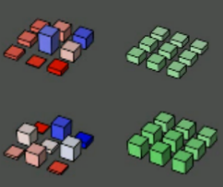
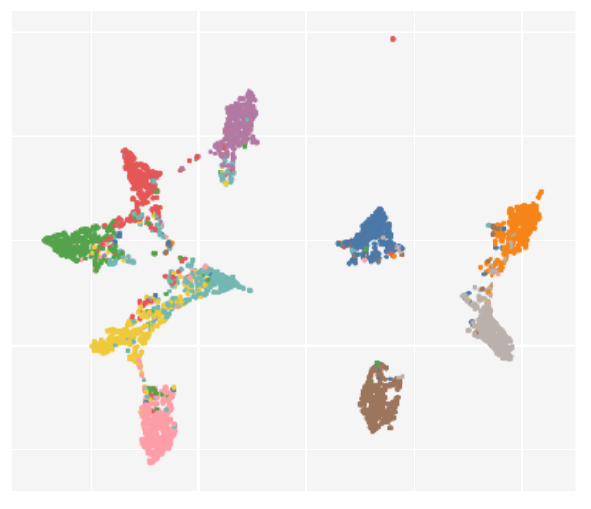
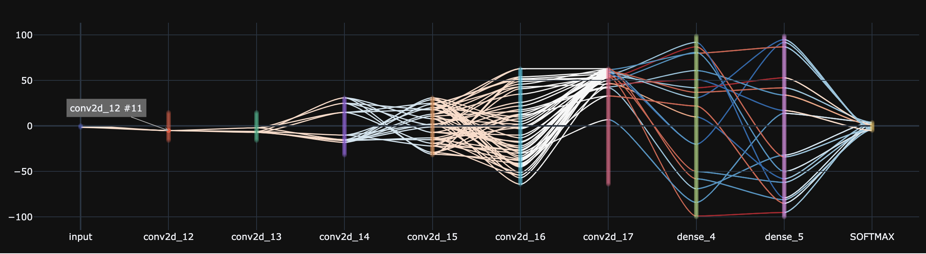
Our solution
Deep Learning Interpretability is a vast research scope
Exploring different perspectives (and goals)
3 complementary concepts
DNN-Monitor
Embedding Viewer
DNN-Viewer
(a)
(b)
(c)

Slide 7
Organization
a
Romain LEGRAND
Matthieu DESSE
DNN-Monitor
CIFAR-10
LeNet-5
b
Sébastien DAVID
Deep Embedding Viewer
CIFAR-10
VGG-16
c
Antoine HUE
Matthieu DESSE
DNN-Viewer
CIFAR-10
LeNet-5, GAN

Slide 8
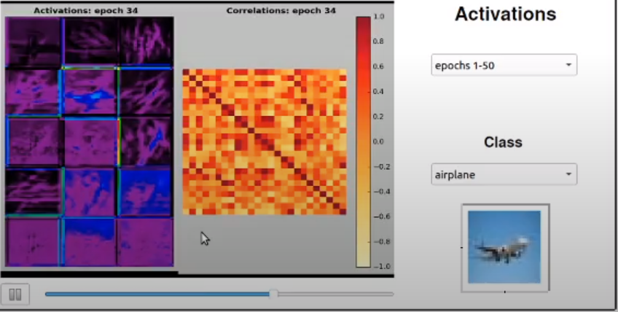
DNN-Monitor
Monitor evolution of baseline metrics across epochs
Notes:
Durée : 3 minutes

Slide 9
Observations and Intuitions
Quality of training primarily determined by update of coefficients
Gradient and weights are two main concepts in DNN (forward and back-propagation).
The aim is to create several custom metrics to visualise the evolution of the system across epochs
Visualization of custom metrics:
loss and accuracy
weights and gradients
activations and correlations between filters

Slide 10
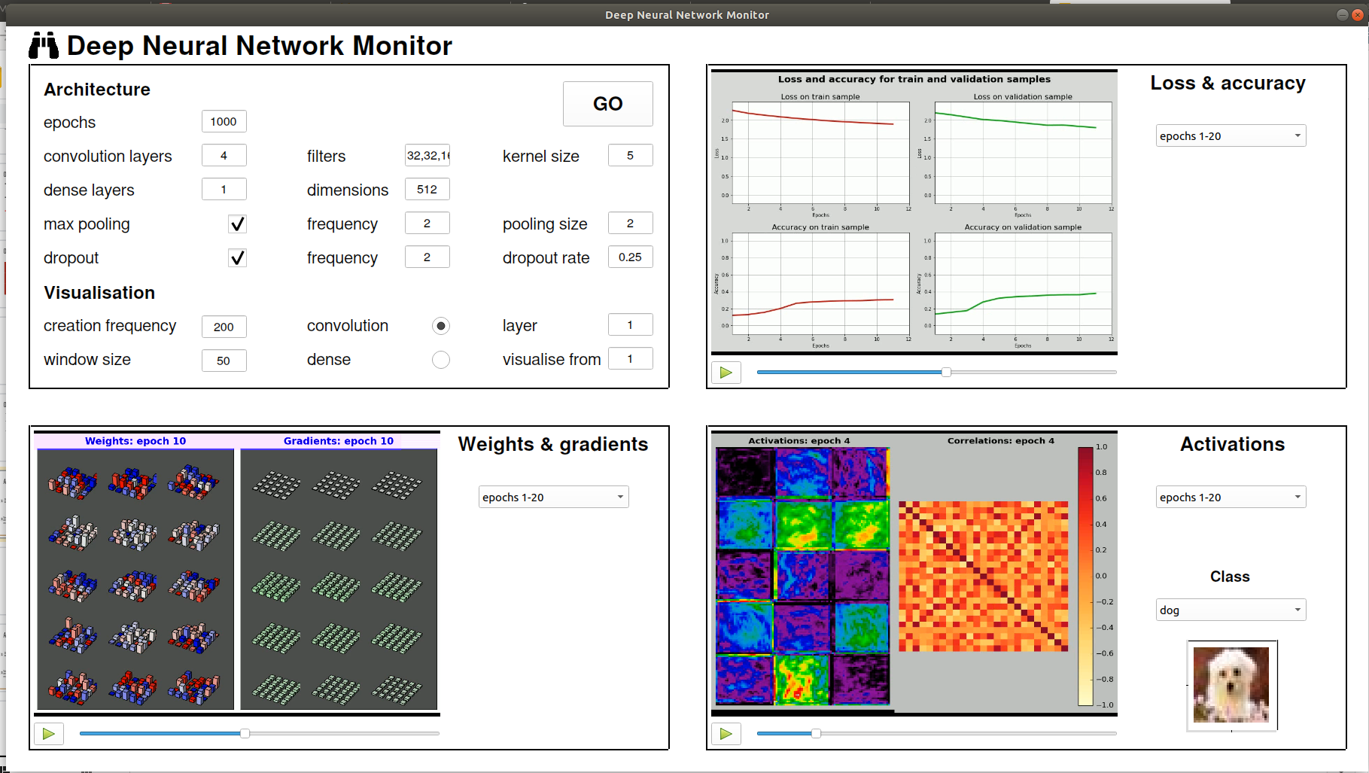
A GUI splits into 4 parts
Visualise evolution of training/validation loss and accuracy
Define an architecture
1
2
Visualise activations and correlations between filters
Visualise weights and gradients evolution
3
4

Slide 11
Interactive Demo

Slide 12

Offline Demo

Slide 13
Deep Embedding Viewer
Visualizing Layer Representations with Dimensionality Reduction
Notes:
Durée de la slide : 15 secondes

Slide 14
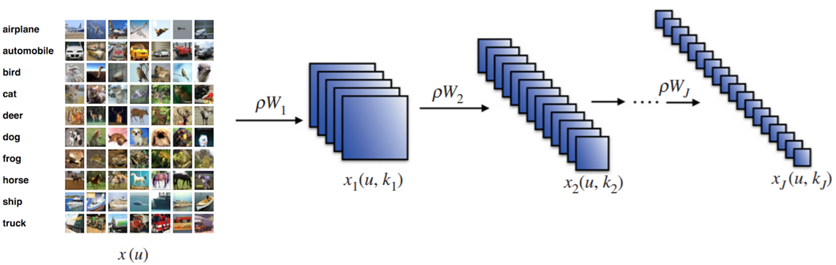
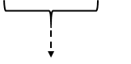
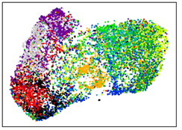
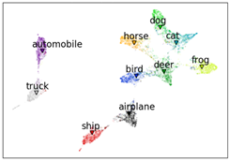
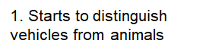
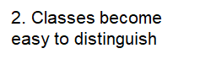
Deep Embedding Viewer
Refresher
Embeddings
Notes:
Durée de la slide : 45 secondes

Slide 15
Tech Demo

Slide 16
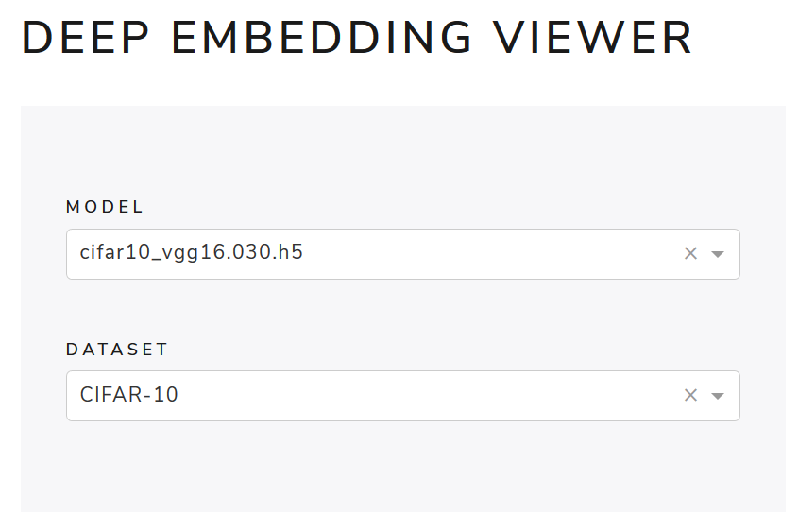
Deep Embedding Viewer
Tech Demo (offline)
Notes:
BACK-UP SLIDE

Slide 17
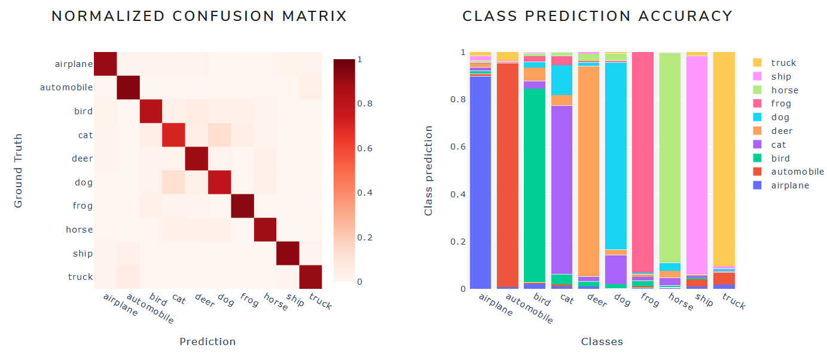
Deep Embedding Viewer
Tech Demo (offline)
Notes:
BACK-UP SLIDE

Slide 18
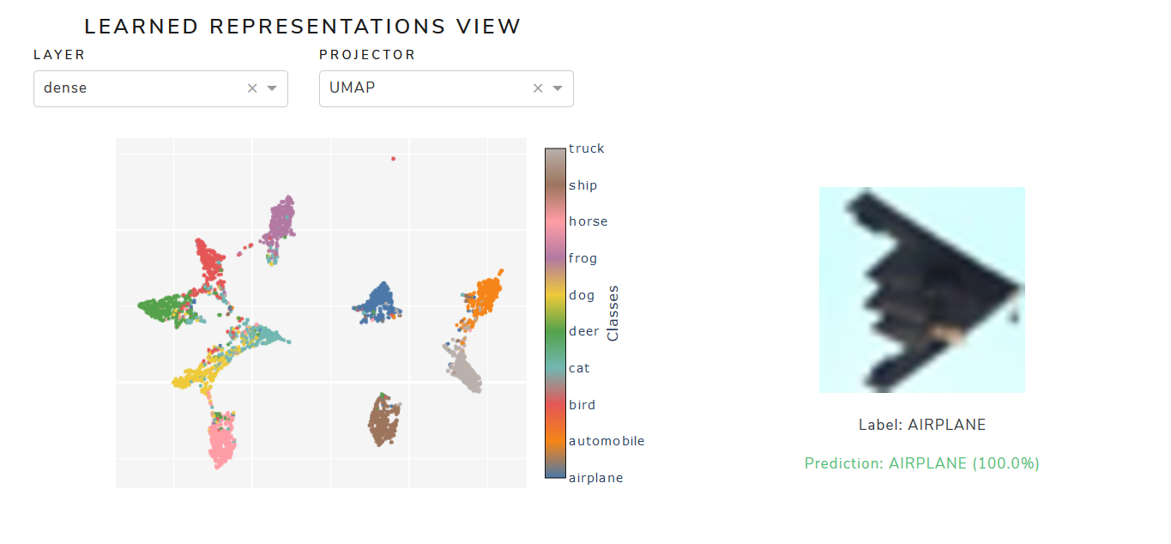
Deep Embedding Viewer
Tech Demo (offline)
Notes:
BACK-UP SLIDE

Slide 19
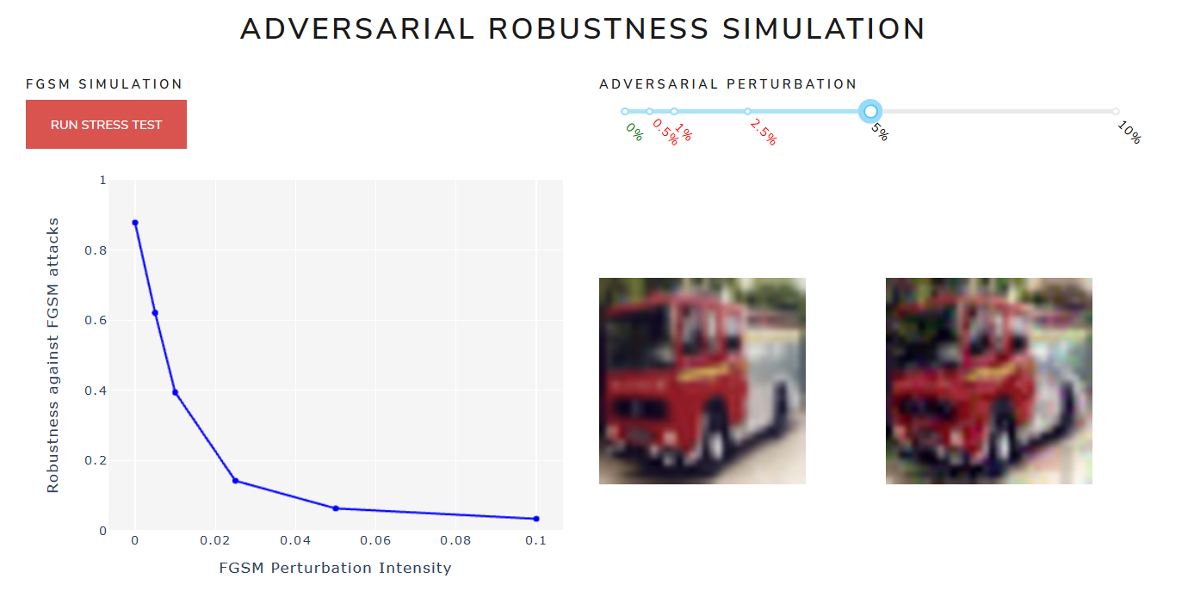
Deep Embedding Viewer
Tech Demo (offline)
Notes:
BACK-UP SLIDE

Slide 20
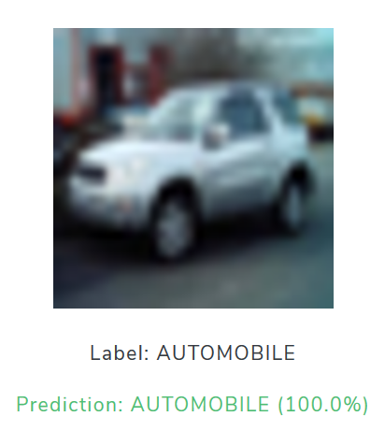
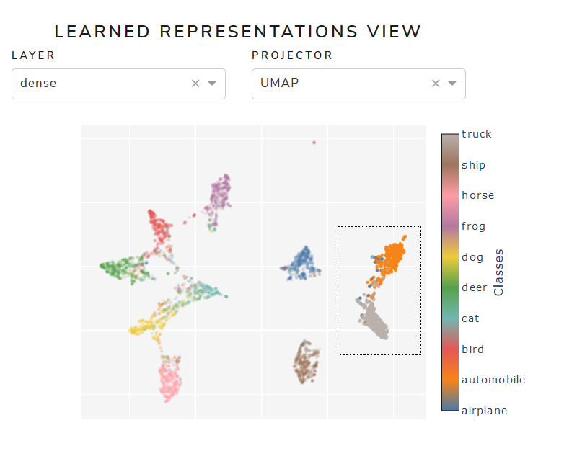
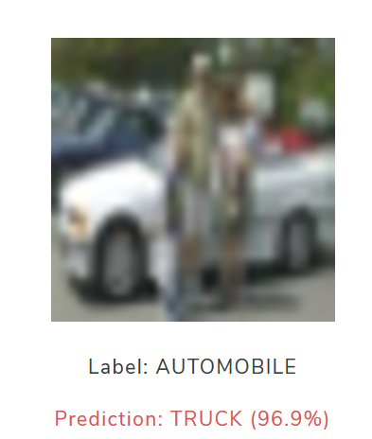
Deep Embedding Viewer
Tech Demo (offline)
Notes:
BACK-UP SLIDE

Slide 21
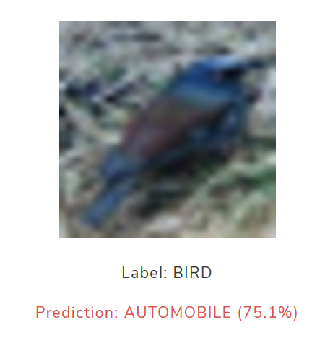
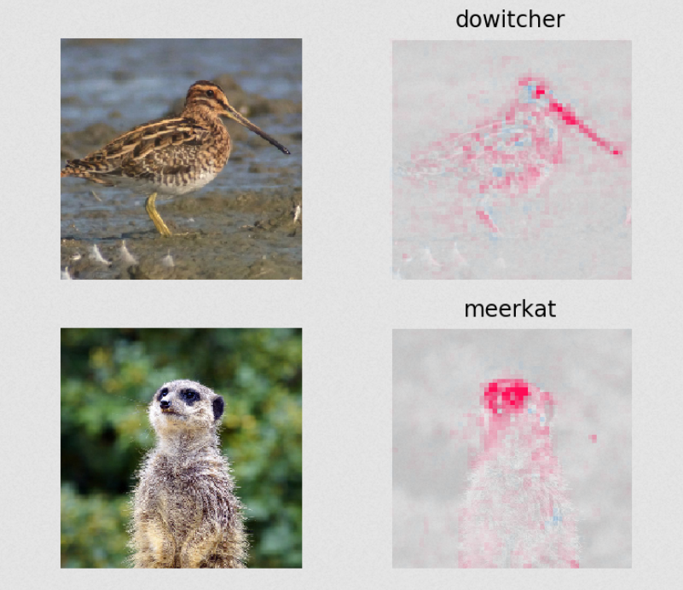
Deep Embedding Viewer
Tech Demo (offline)
Solution: SHAP Coefficients ?
Notes:
BACK-UP SLIDE

Slide 22
DNN Viewer
Inspection of - architecture, - learnt parameters, - performance over epochs
$ pip install dnnviewer
Notes:
Durée : 3 minutes

Slide 23
Observations and Intuitions
Most techniques presented in the bibliography are assuming a layer or unit has been selected
A graphical user interface to click and select units would be very helpful
Each unit should be evaluated with test data (e.g. activation, saliency) and within the network graph
The user interface will allow navigation up and down the graph
Even the consolidated views over a dataset (e.g. t-SNE, UMAP) require layer/unit selection

Slide 24
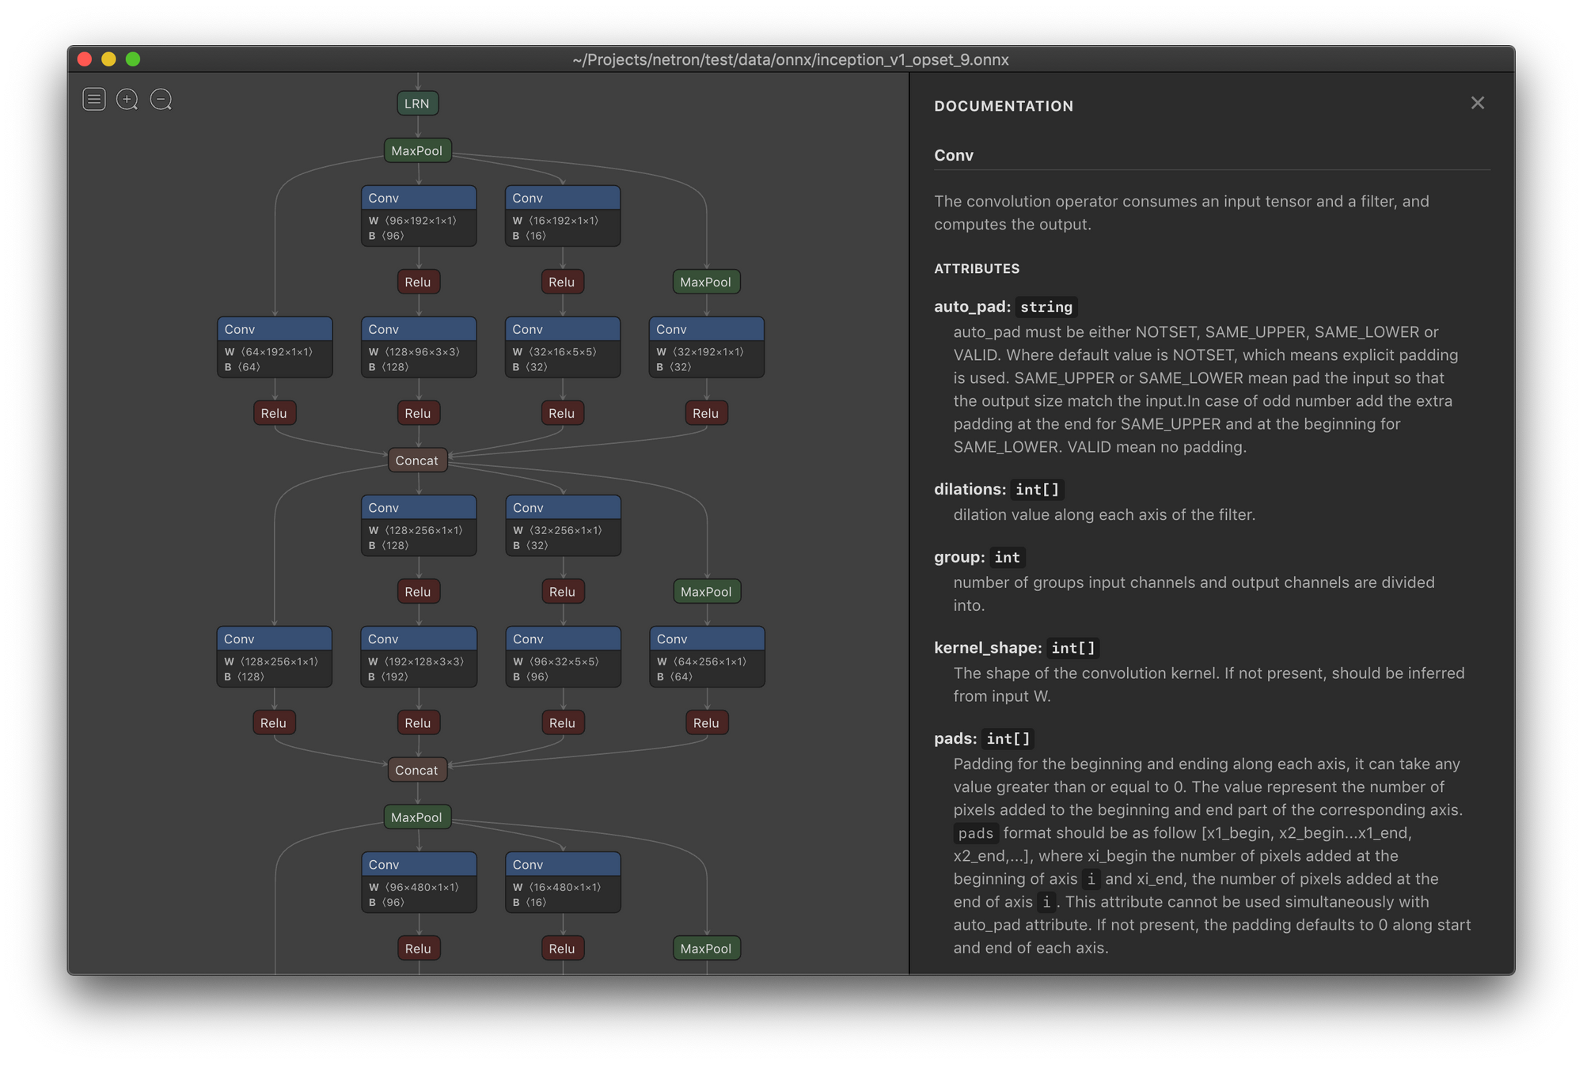
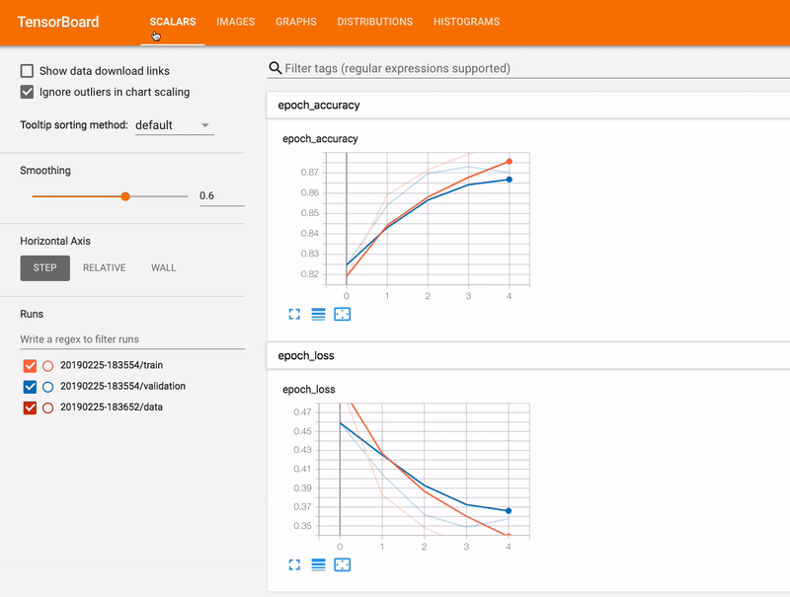
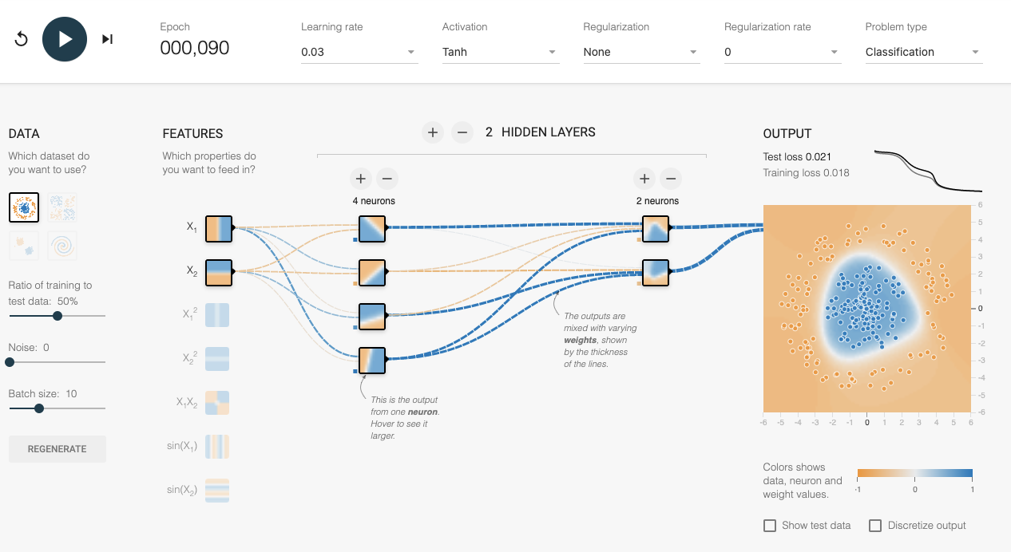
Netron
Tensorboard
playground.tensorflow.org

Slide 25
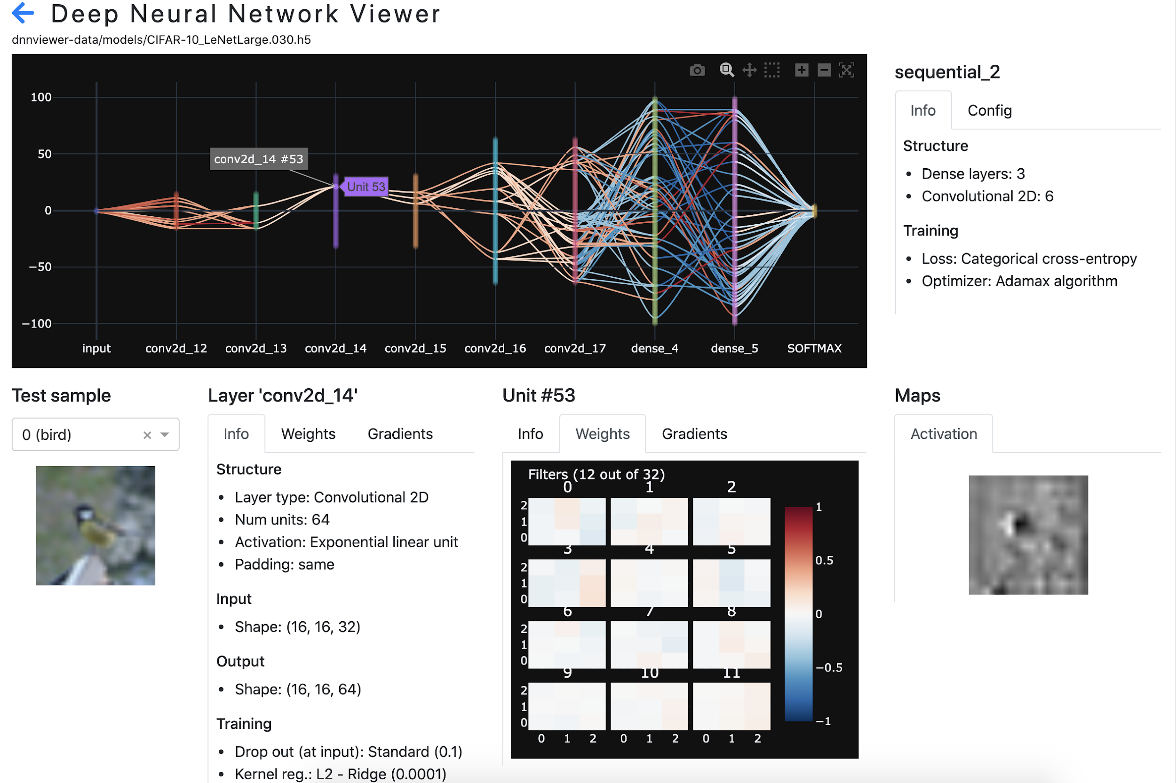
Deep Neural Network Viewer https://github.com/tonio73/dnnviewer
A graphical user interface to inspect:
architecture,
learnt parameters
gradients
activation maps
of a deep neural network
Distributed on Pipy
$ pip install dnnviewer

Slide 26
Interactive Demo
DNN Viewer

Slide 27
Conclusion

Slide 28
Next steps
Axes d’amélioration :
saliency
exemples adversariaux
custom metrics (TDB)
The developed tools are of interest for pedagogical teaching and professional use
We want to promote their use within the academic and open source communities
We will pursue the open source projects to broaden their capabilities

Slide 29
Backup slides

Slide 30
DNN Viewer status
Downloads
June (until 15th) | 1797
May | 1165
April | 2064
Distributed on Pypi (pip install dnnviewer)
Version 0.1.0 - released
Support for the 2D image classification (Dense, Convo 2D, Dropout, Pooling, Batch norm layers)
3 test datasets (MNIST, Fashion MNIST, CIFAR10)
Weights, gradients, Saliency maps
Descriptive properties (num units, strides, regularization…)
25 development and validation tasks
Version 0.2.0 - on-going
Many more test datasets (using Tensorflow Dataset)
GAN support: generator, multi-level Sequential network, upsample & transpose convolution
Input * Weight contribution graph for dense layers
16 development tasks so far

Slide 31
DNN Viewer Use cases
DNN Viewer

Slide 32
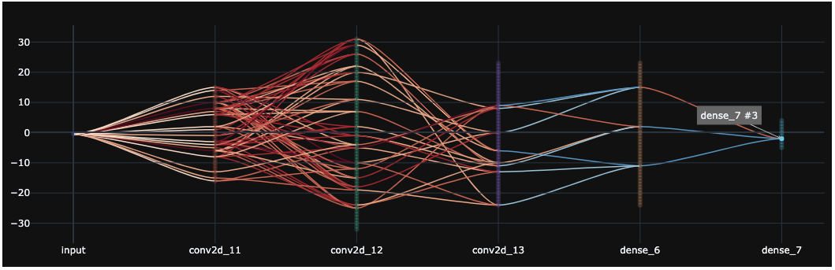
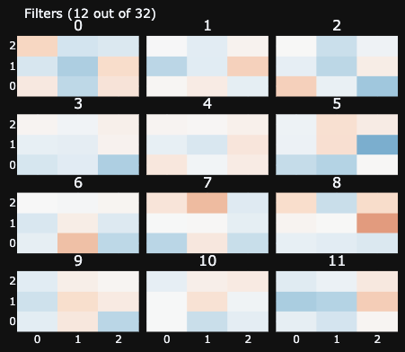
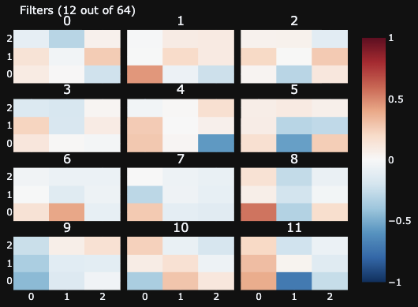
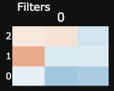
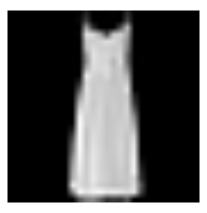
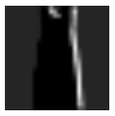
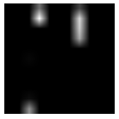

DNN Viewer forward activation
Fashion MNIST classification
3 convolutional layers
2 dense layers
Accuracy ~92%
Conv #1
Conv #2
Conv #3

Slide 33
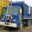
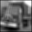
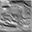
DNN Viewer forward on deeper network
CIFAR-10 classification
6 convolutional layers
3 dense layers
Accuracy ~85%
Conv #1
Unit #13
Conv #2
Unit #1
Conv #3
Unit #23
Conv #4
Unit #26
Conv #5
Unit #17
Conv #6
Unit #43

Slide 34
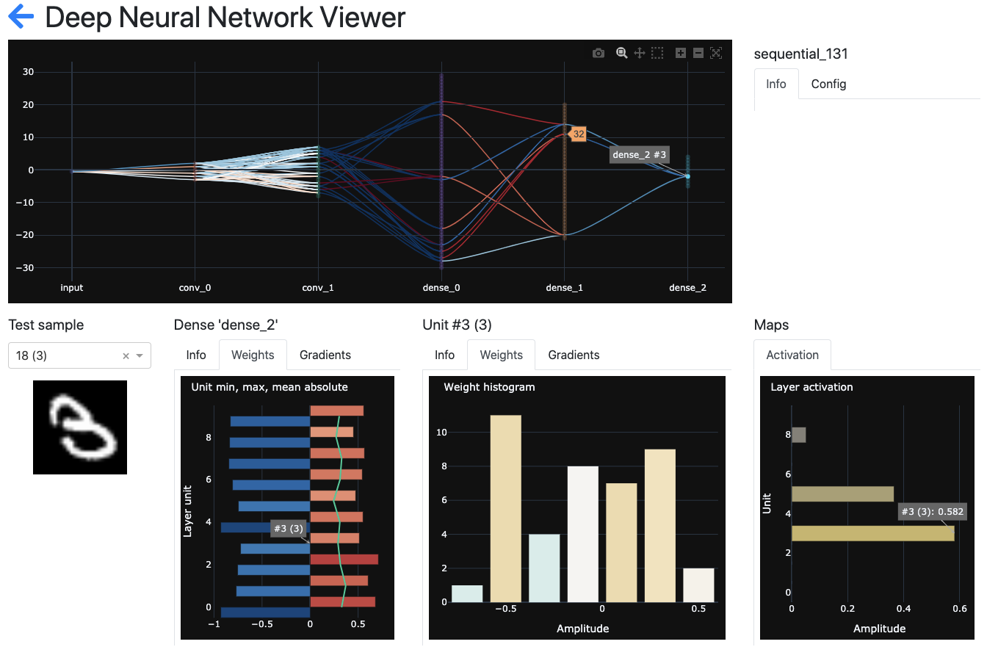
Backward inspection
Starting from an output, a target class, inspect the neurons in previous layers contributing positively or negatively to the activation on this class, given an input sample

Slide 35
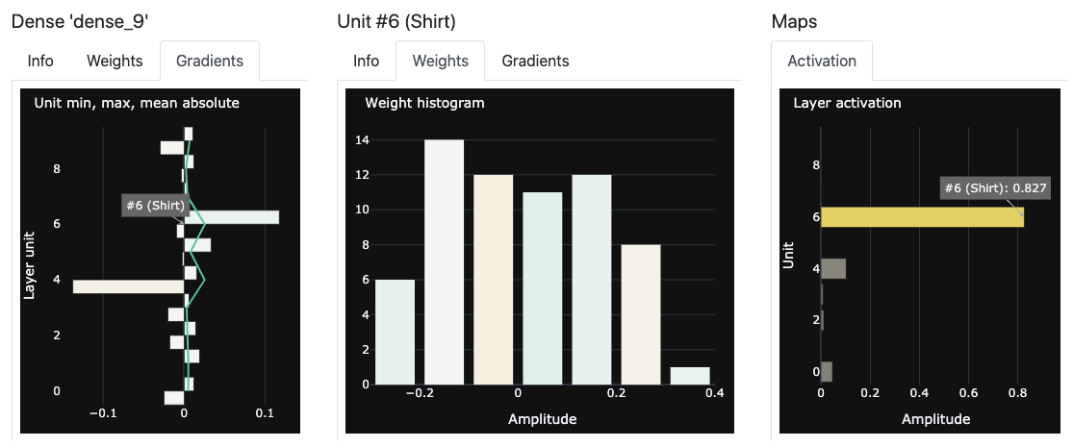
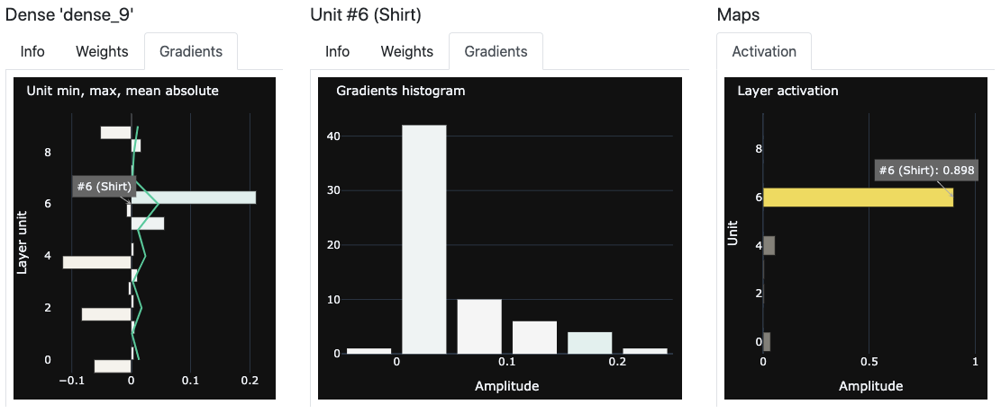
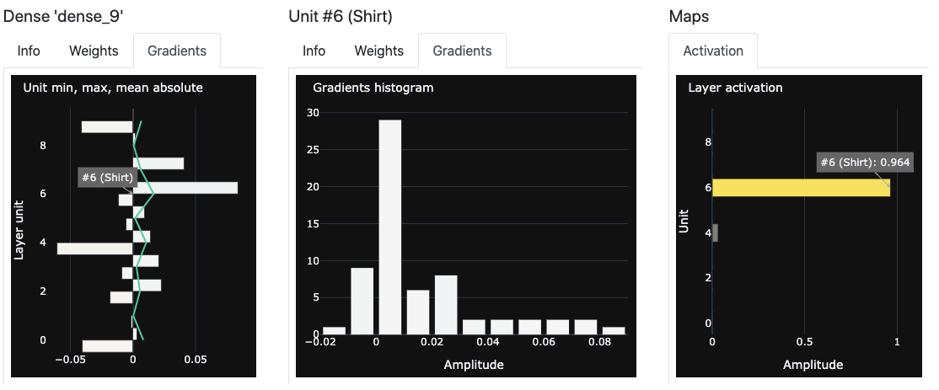
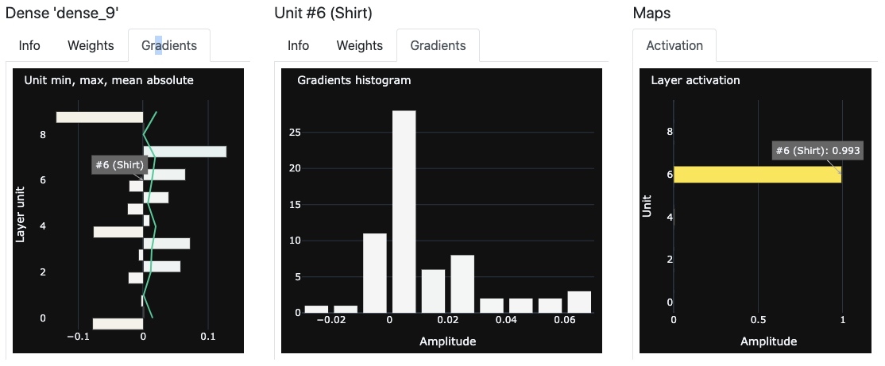
Inspection over epochs
Inspect activations, weights and gradients over epochs
Epoch 2
Epoch 5
Epoch 15
Epoch 25

Slide 36
DNN Viewer implementation

Slide 37
DNN Viewer software stack
DNN Viewer
DNN Viewer application
Dash
Dash components
Dash Bootstrap components
Flask web server
Plotly
React.js
Plotly.js
Python runtime
Browser (JS runtime)
Serveur
Client

Slide 38
DNN Viewer architecture
main
Dash app
Flask server
widgets.
Router
Grapher
bridge.
AbstractModelSequence
Implement
pages[] : AbstractDashboard
layers[] : layers.AbstractLayer
bridge.
KerasModelSequence
Implement
Implement
main_model_selection
main_network_view
layers.Convo2D
layers.Dense
layers.Input

Slide 39
DNN Viewer layer connection plot
Continue backward with active list
Connected unit become “active”
Selected
Unit
Continue forward with active list

Slide 40
Project status
Old-fashioaned
After a bibliographic work, we have developed several proof of concepts of visualisation tools.
The aim is to visualise the training and the performance of a CNN for the picture classification task.
Nota bene : we do not have any news from our partner since the P2 meeting, that is why we have followed our own intuitions and wills.

Slide 41
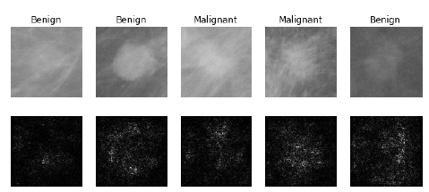
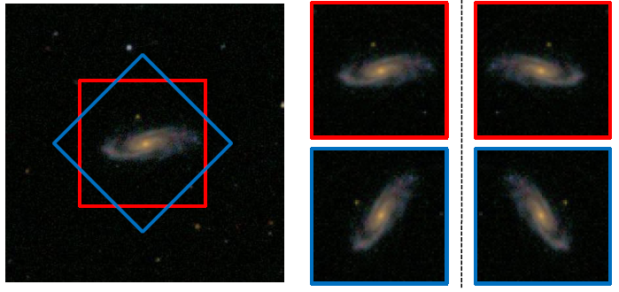
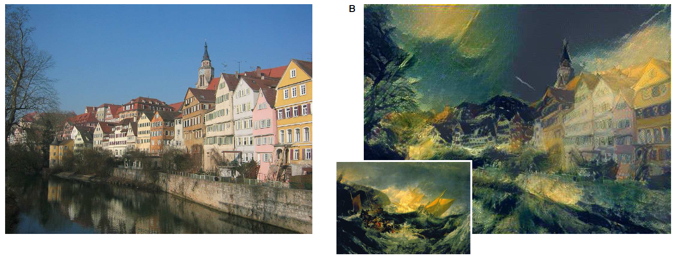
Context
Old-fashioaned
Réseaux de neurone:
MLP: Rosenblatt (1958), Rumelhart et al. (1986).
CNN: Fukushima (1980), LeCun et al. (1989, 1998).
Renaissance du deep learning:
2011: reconnaissance du langage, Microsoft: Seide et al. (2011).
2012: AlexNet remporte l’ILSVRC: Krizhevsky et al. (2012).
Deep learning est partout:
Vision par ordinateur (Szegedy et al. (2015)), recherche médicale (Lévy et al. (2016)), astronomie (Dieleman et al. (2014)), art (Gatys et al. (2016)).
Enjeux:
Boîte noire (Alain and Bengio (2016): enjeux d’interprétabilité.
Projet: utiliser la visualisation pour comprendre le processus de décision.
Approche: visualiser (saliency map); analyser l’échec (exemples adverses).

Slide 42
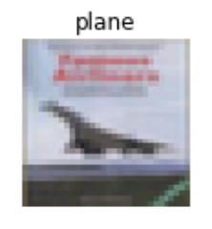
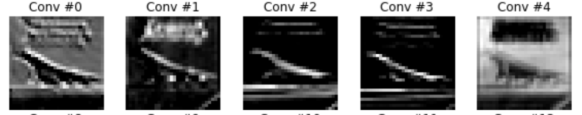
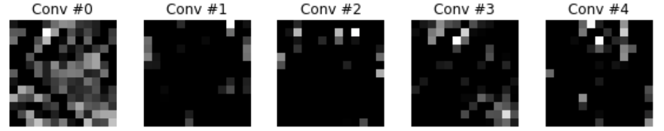
Activations maps
Old-fashioaned
Montrer la sortie d’un neurone pour une image en entrée
Difficultés :
Nombre élevé de neurones sur chaque couche
Non interprétable au delà de la 2nde couche
Dépendances entre les couches non observables
S’applique à une ou quelques images seulement
32 convolutions total
f⁽¹⁾
f⁽²⁾
...
64 convolutions total
Notes:
Caractéristiques du filtre
Perte en interprétrabilité au cours du temps => réduction de dimension + Plus haute abstraction (profondeur image / filtre)

Slide 43
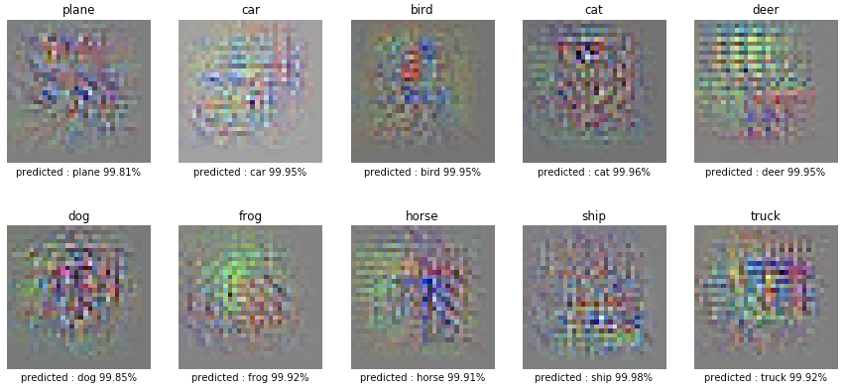
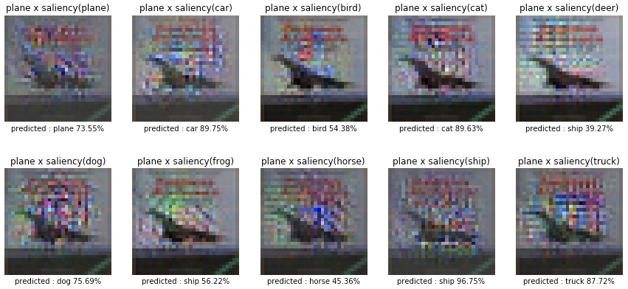
2. Saliency (CIFAR-10)
Old-fashioaned
X
=
Adverse !

